Slide 1
CPE 301
Lab #3 – The Memory Lab

Slide 2
Contents:
Logic Levels
Breadboards
IC’s & Datasheets Reminders
How to wire switches
Hex -> Binary
The Lab

Slide 3
Logic Levels
Digital logic -> 2 states
On
Off
Tri-State logic -> 3 states
On
Off
Floating, High Impedance
 | Binary | Logic | Rails | TTL | CMOS | RS-232
ON | 1 | “High” | “Power” | +5V (2.0V-Vcc) | +3.3V (2/3Vdd-Vdd) | -15V to -3V
OFF | 0 | “Low” | “Ground” | 0V (0V-0.8V) | 0V (0-1/3Vdd) | +15V to +3V

Slide 4
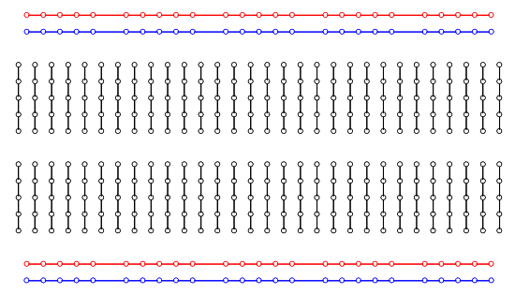
Breadboards
Rows & Rails:
Try to use jumpers as follows:
Power | Ground | Signal
Red, Orange, Yellow | Black, Brown, Blue, Green | White, Green, Purple, Blue, Yellow

Slide 5
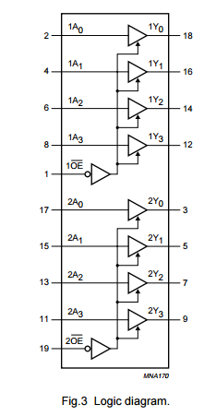
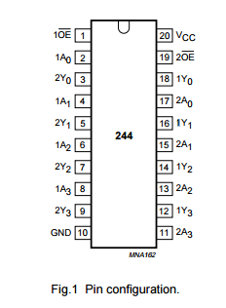
IC’s & Datasheets
Pin-out vs. Logic Diagram

Slide 6
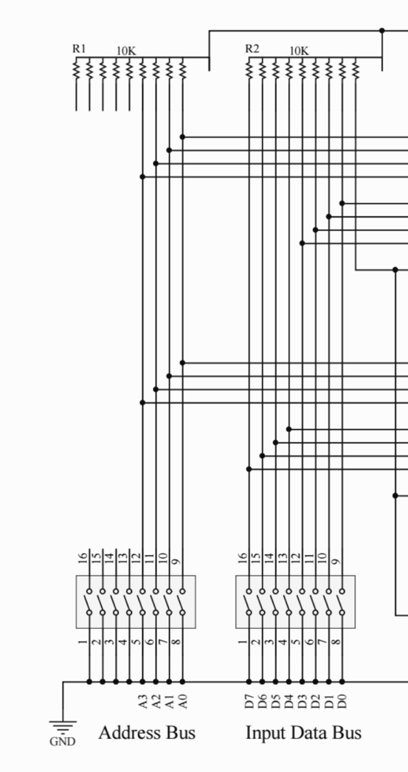
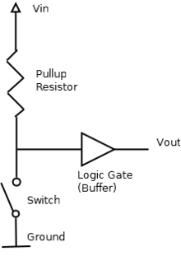
How to wire switches
Pull-up Resistors
What is the voltage at the pin when the switch is closed? Open?

Slide 7
Hex -> Binary
Pay attention to MSB/LSB
Try to put MSB on LEFT
0x FF
0b 1111 1111
0d 256

Slide 8
The Lab
RTFM
2 Circuits:
16x8
32x4
16x8 is simpler
Wire the switches first -> TEST & UNDERSTAND
Write down -> OPEN = HIGH / LOW, CLOSED = HIGH / LOW
Then Wire the chips:
Power & Ground
Control Signals
Data
Present the table of addresses and data in binary and hex to your TA

Slide 9
Tables
# | HEX |  | BINARY
 | Address | Data | A3 | A2 | A1 | A0 | B7 | B6 | B5 | B4 | B3 | B2 | B1 | B0
1
2
3
4
# | HEX |  | BINARY
 | Address | Data | A4 | A3 | A2 | A1 | A0 | B3 | B2 | B1 | B0
1
2
3
4

